Slide 1
‘N’ Queens Problem

Slide 2
‘N’ Queens problem
Now ‘n’ queens are to be placed on an n x n chessboard so that no two attack; that is, no two queens are on the same row, column, or diagonal. Generalizing the discussion the solution space consists of all n! permutations of the n-tuple(1,2,,n )
Explicit constraints for this problem that restrict each x_{i} to take on values only from a given set ie 1<= x_{i} <= n
The implicit constraints for this problem are that no two x_{i}’s can be the same(i.e. all Queens must be on different columns)and no two queens can be on the same diagonal
The first of these two constraints implies that all solutions are permutations of the 4-tuple(1,2,3,4).This realization reduces the size of the solution space from 4⁴ tuples to 4! tuple

Slide 3
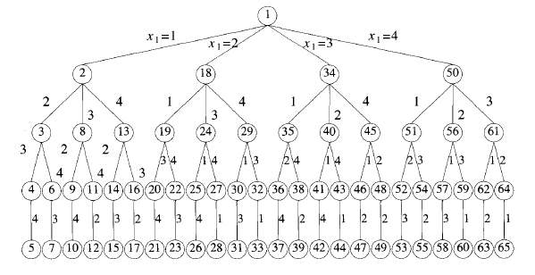
4 Queens problem

Slide 4
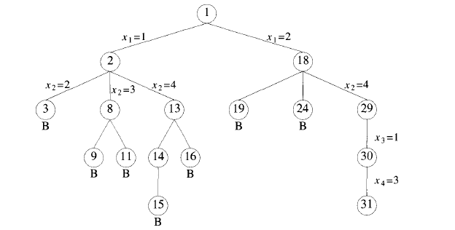
4 Queens problem

Slide 5
BACKTRACKING (4 Queens problem)
Example :
1
1
. | . | 2
1
 |  |  | 2
1
 |  | 2
. | 3 . | . .
 | 1
 | 1
 |  |  | 2
3 . | ,
 |  | 4

Slide 6
BACKTRACKING (Contd..)
We start with root node as the only live node. The path is ( ); we generate a child node 2.
The path is (1).This corresponds to placing queen 1 on column 1 .
Node 2 becomes the E node. Node 3 is generated and immediately killed. (because x1=1,x2=2).
As node 3 is killed, nodes 4,5,6,7 need not be generated.

Slide 7
The n-queens problem and solution
In implementing the n – queens problem we imagine the chessboard as a two-dimensional array A (1 : n, 1 : n).
The condition to test whether two queens, at positions (i, j) and (k, l) are on the same row or column is simply to check i = k or j = l
The conditions to test whether two queens are on the same diagonal or not are to be found

Slide 8
The n-queens problem and solution contd..
Observe that
For the elements in the the upper left to lower Right diagonal, the row - column values are same or row- column = 0,
e.g. 1-1=2-2=3-3=4-4=0
For the elements in the upper right to the lower left diagonal, row
+ column value is the same e.g. 1+4=2+3=3+2=4+1=5
(1,1) | (1,2) | (1,3) | (1,4)
(2,1) | (2,2) | (2,3) | (2,4)
(3,1) | (3,2) | (3,3) | (3,4)
(4,1) | (4,2) | (4,3) | (4,4)

Slide 9
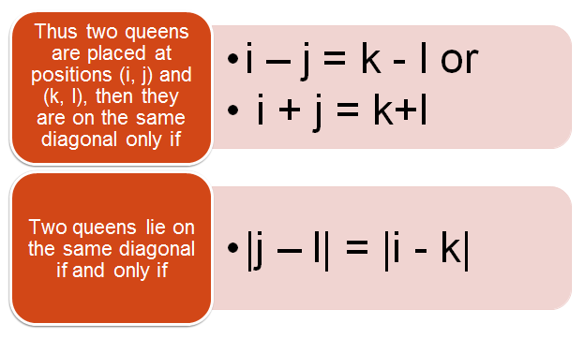
The n-queens problem and solution contd..
|j – l| = |i - k|

Slide 10
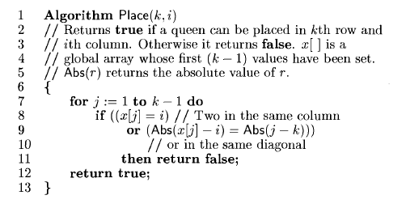
The n-queens problem -Algorithm

Slide 11
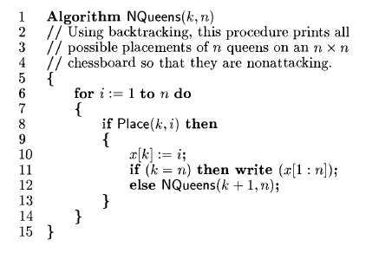
The n-queens problem -Algorithm contd..

